Slide 1



Media DRD for KC-SA Extra Care Active Baby

Slide 2
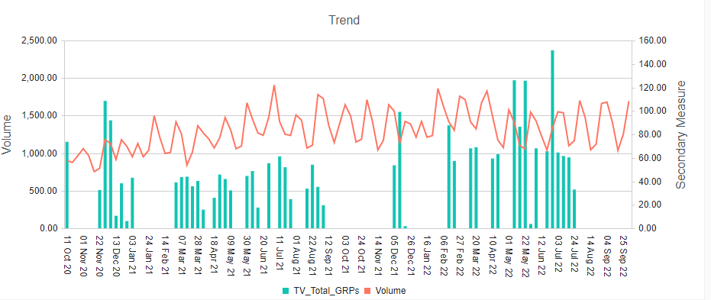
TV GRP’s vs Volume

Slide 3
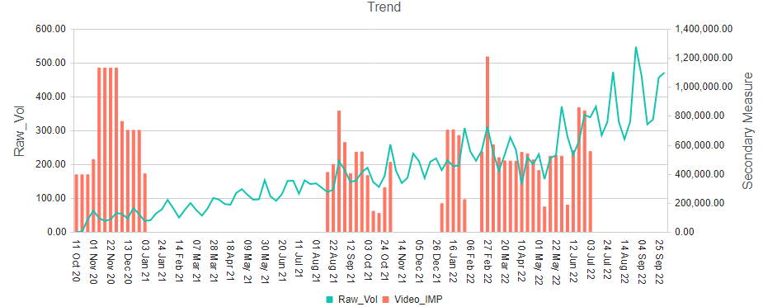
Video Impressions vs Volume

Slide 4
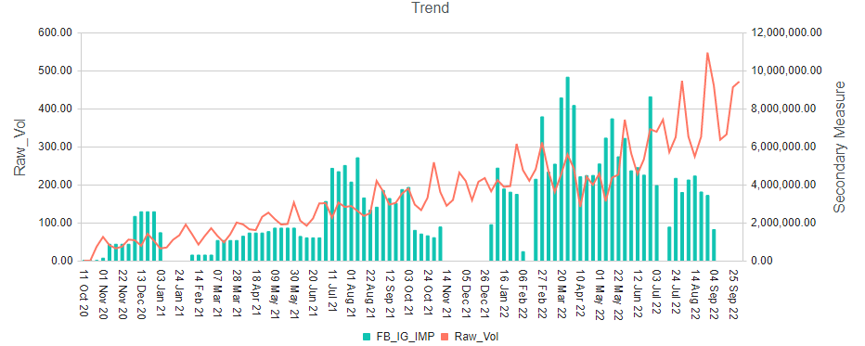
FB Impressions vs Volume

Slide 5
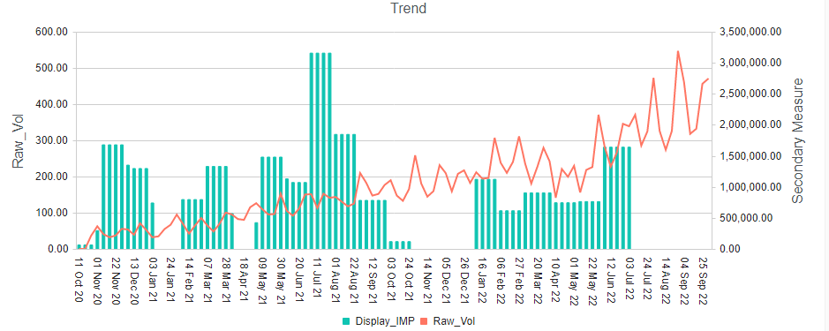
Display Impressions vs Volume

Slide 6
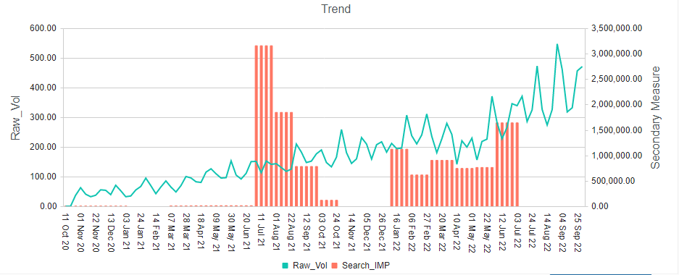
Search Impressions vs Volume

